Slide 1


Slide 2

Agenda
17:00 Welcome to the Guild, sign in
17:15 Mark's welcome address
17:45 Survey link in comments below
18:00 What’s this guild about?
18:15 Next Event & after meeting drinks (Phillips Brewery)

Slide 3


Welcome
Please sign in
Events coming up

Slide 4
Mark’s hello!
Mark is joining us via skype at 17:15

Slide 5
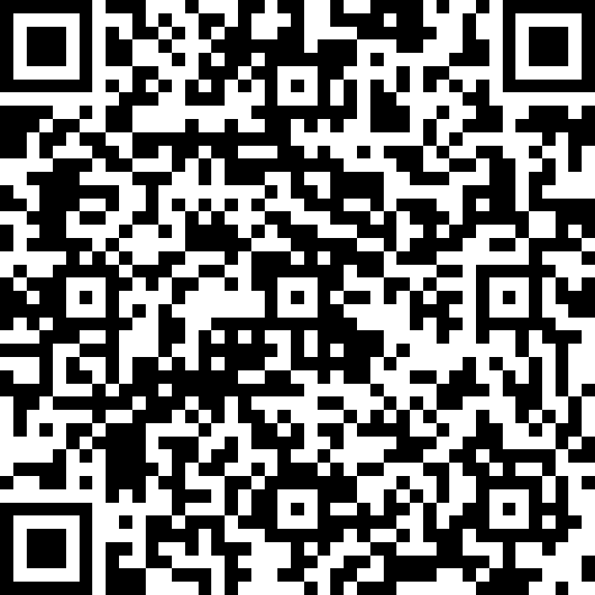
Survey
Please fill out the survey on your device

Slide 6
Approach
Purpose
Support DA professionalism in practice in the local community
Themes (based on survey / community)
Lean Coffee (build agenda, start talking)
Supported by organizations who can co-sponsor / co-host

Slide 7
Giveaways from DA & Tactec
Pick a number between 1 – 100
(signed books)

